Slide 1
Centene Health Insurance Claim Forms
12/11/2019
Notes:
Frame the problem

Slide 2
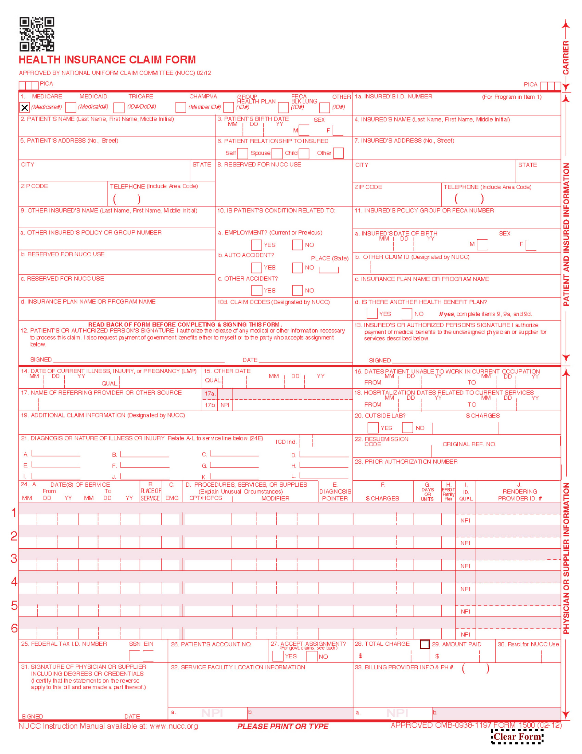
Business Opportunity
2
Notes:
The Business Opportunity that was presented was the need for a way to map filled values to their correct form label when scanner difficulties cause offsets and stretching of the form.
2

Slide 3
Agenda
Initial Investigation
Rotate, Crop, Resize, and Overlay Filled form and Blank Form
Duplicate Existing Method Using Intersection of Bounding Boxes
K-Nearest Neighbor Model Using Top-Left Corner of Text
K-Nearest Neighbor Model Using Center of Text
Methods Comparison
Location Prediction Using Tensorflow, OpenCV & EAST
Future Recommendations
3

Slide 4
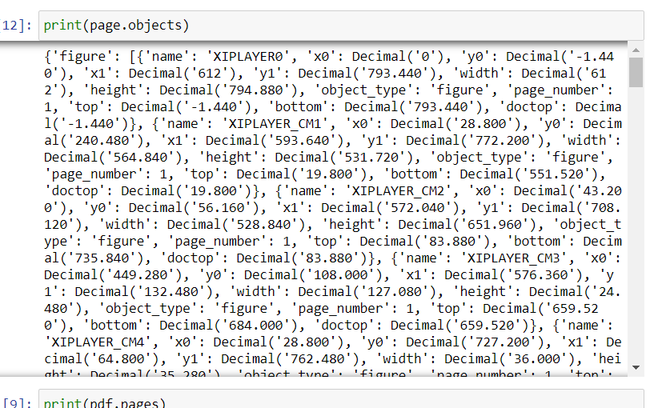
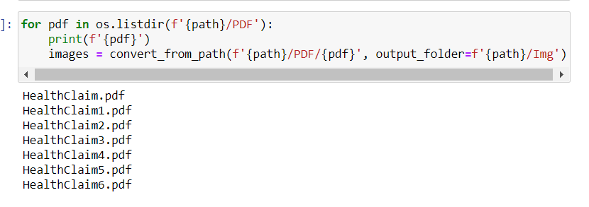
Initial Investigation
4
Notes:
Looking at the objects that were pulled from the pdfplumber script it is clear to see that there is no useful structure being pulled
Therefore pdf2image script used to just separate the pages of the pdf into invidual image files
4

Slide 5
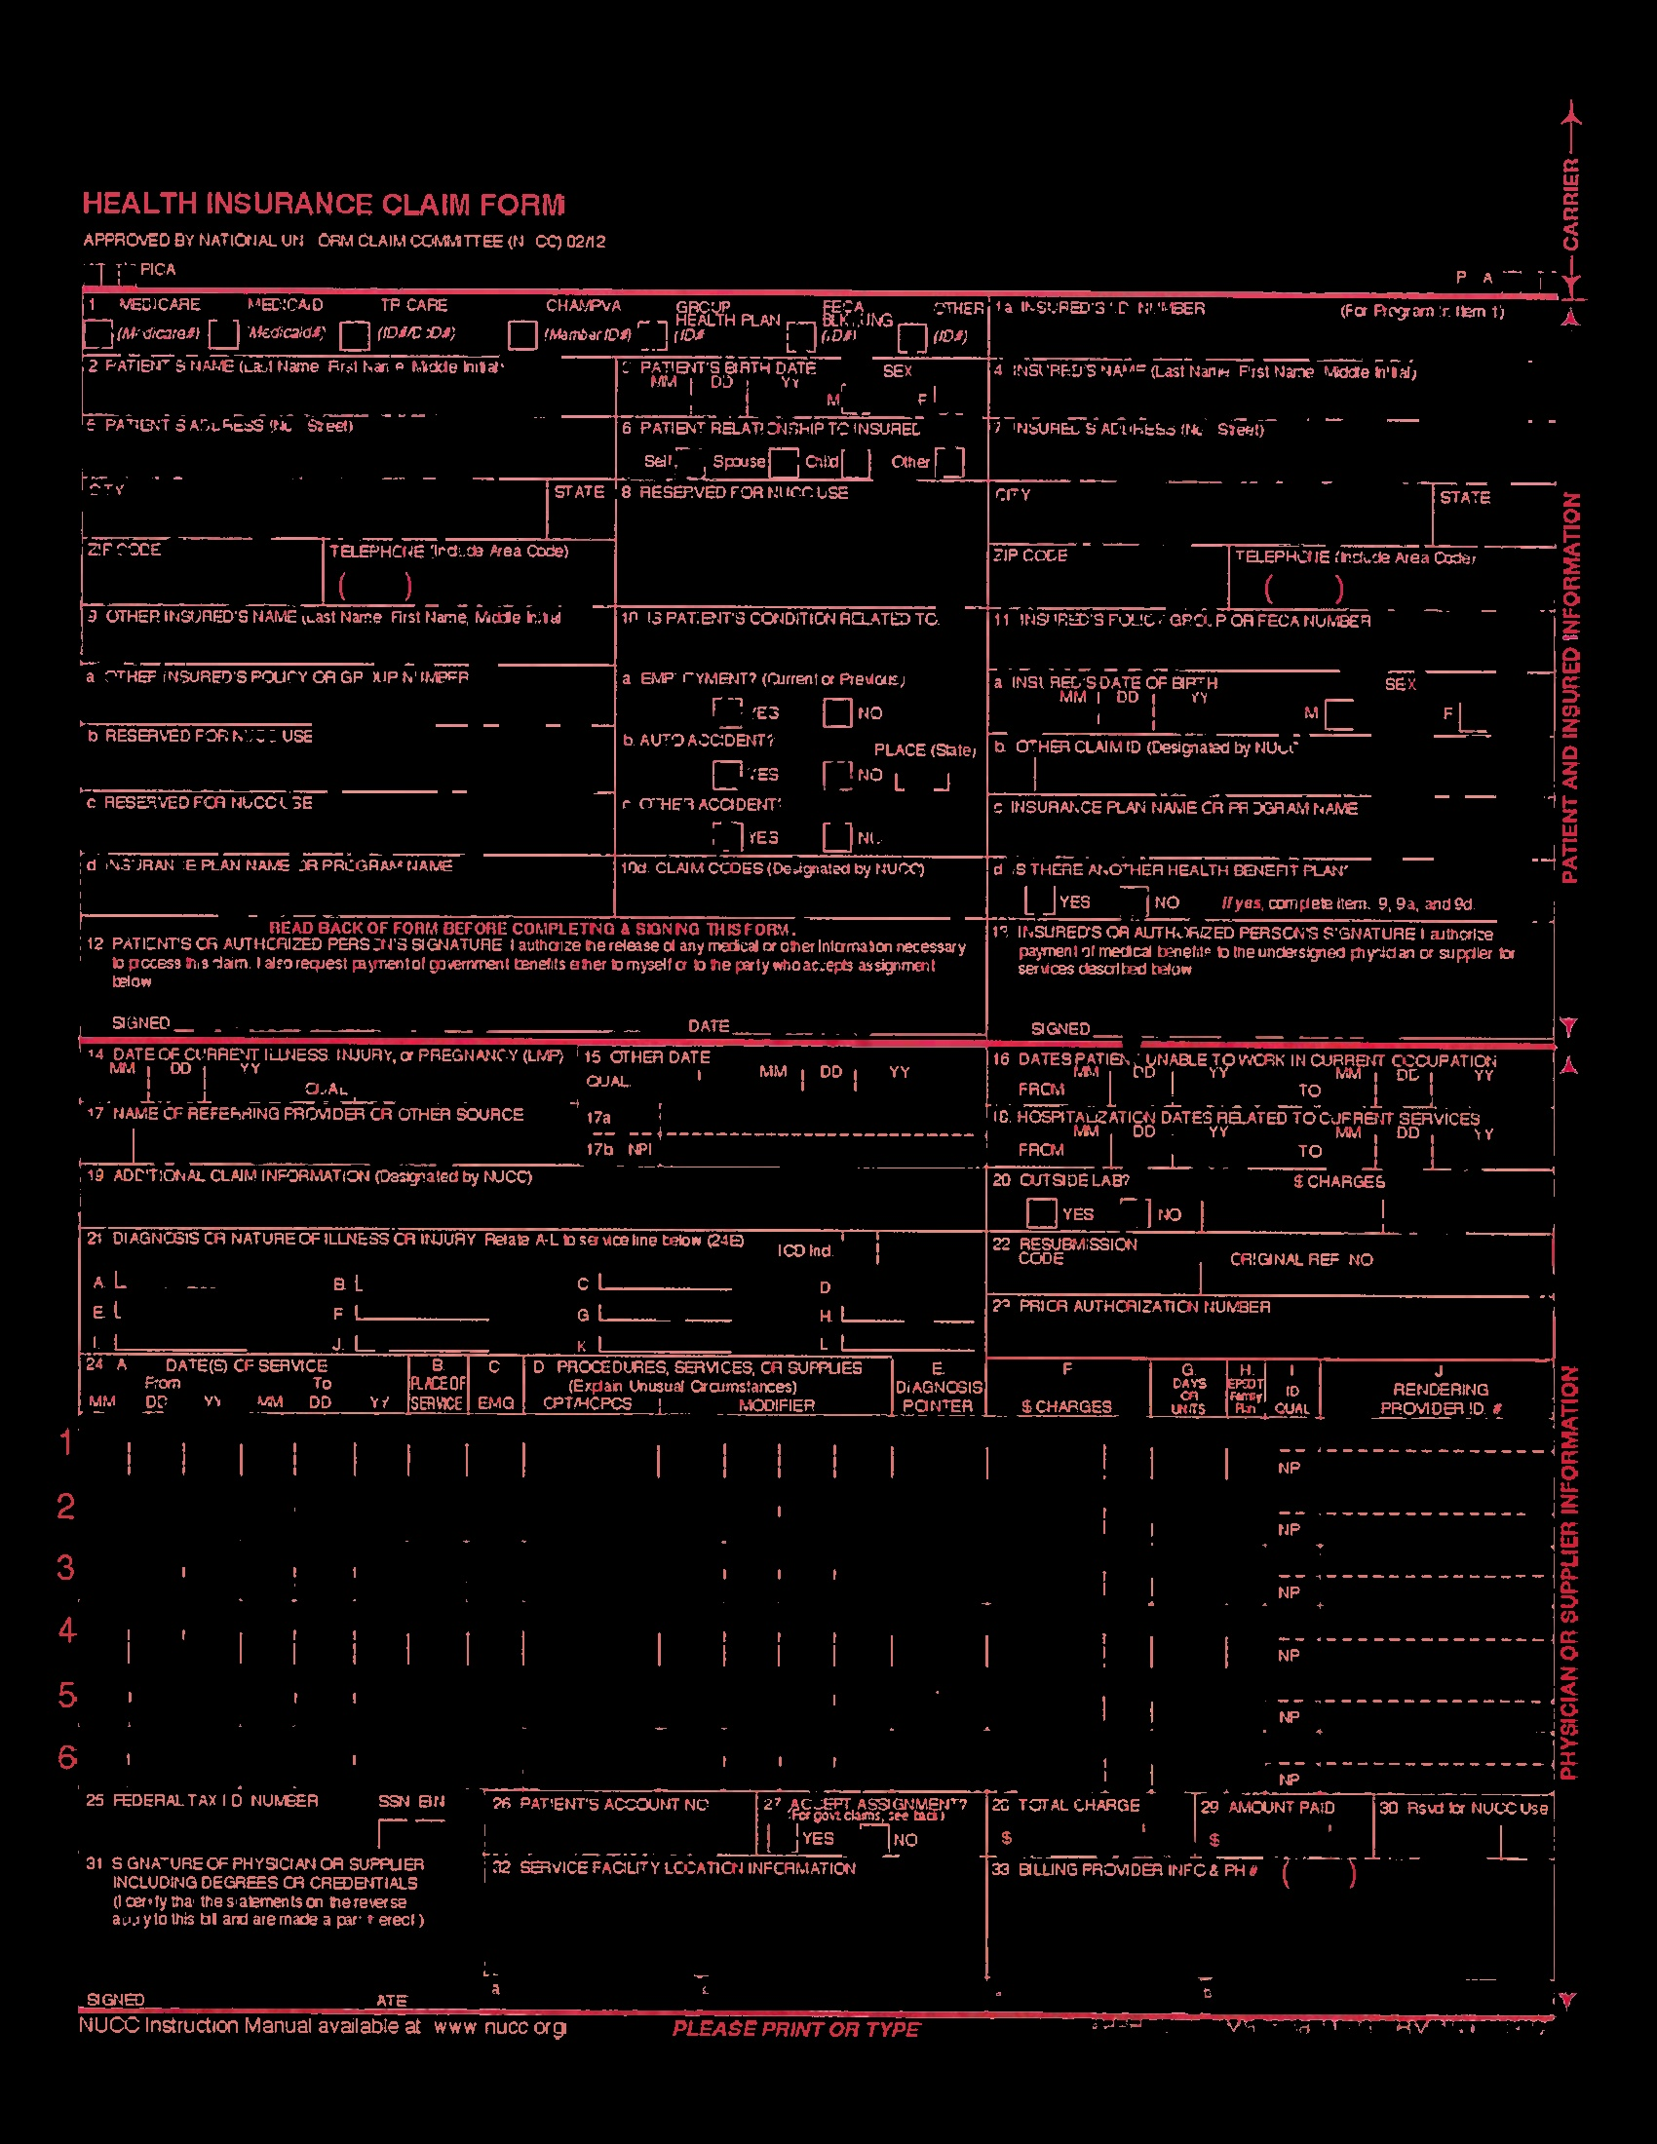
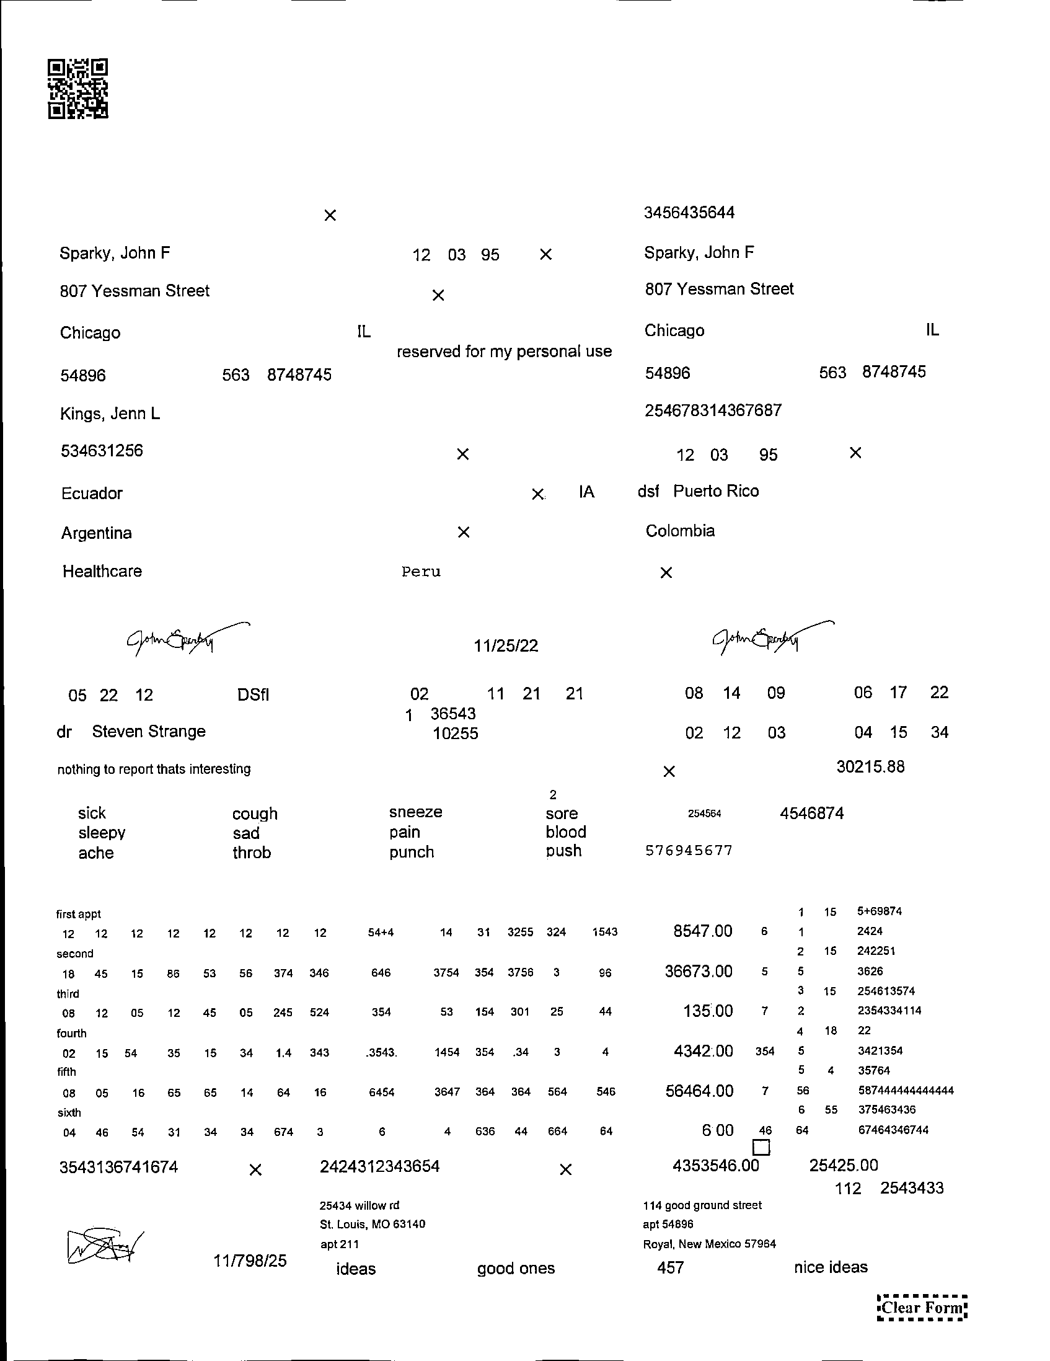
Initial Investigation
5
Notes:
Finally to try and get rid of the background and mimic the prod data masking was attempted and abandoned due to the difficult of matching the red exactly
5

Slide 6
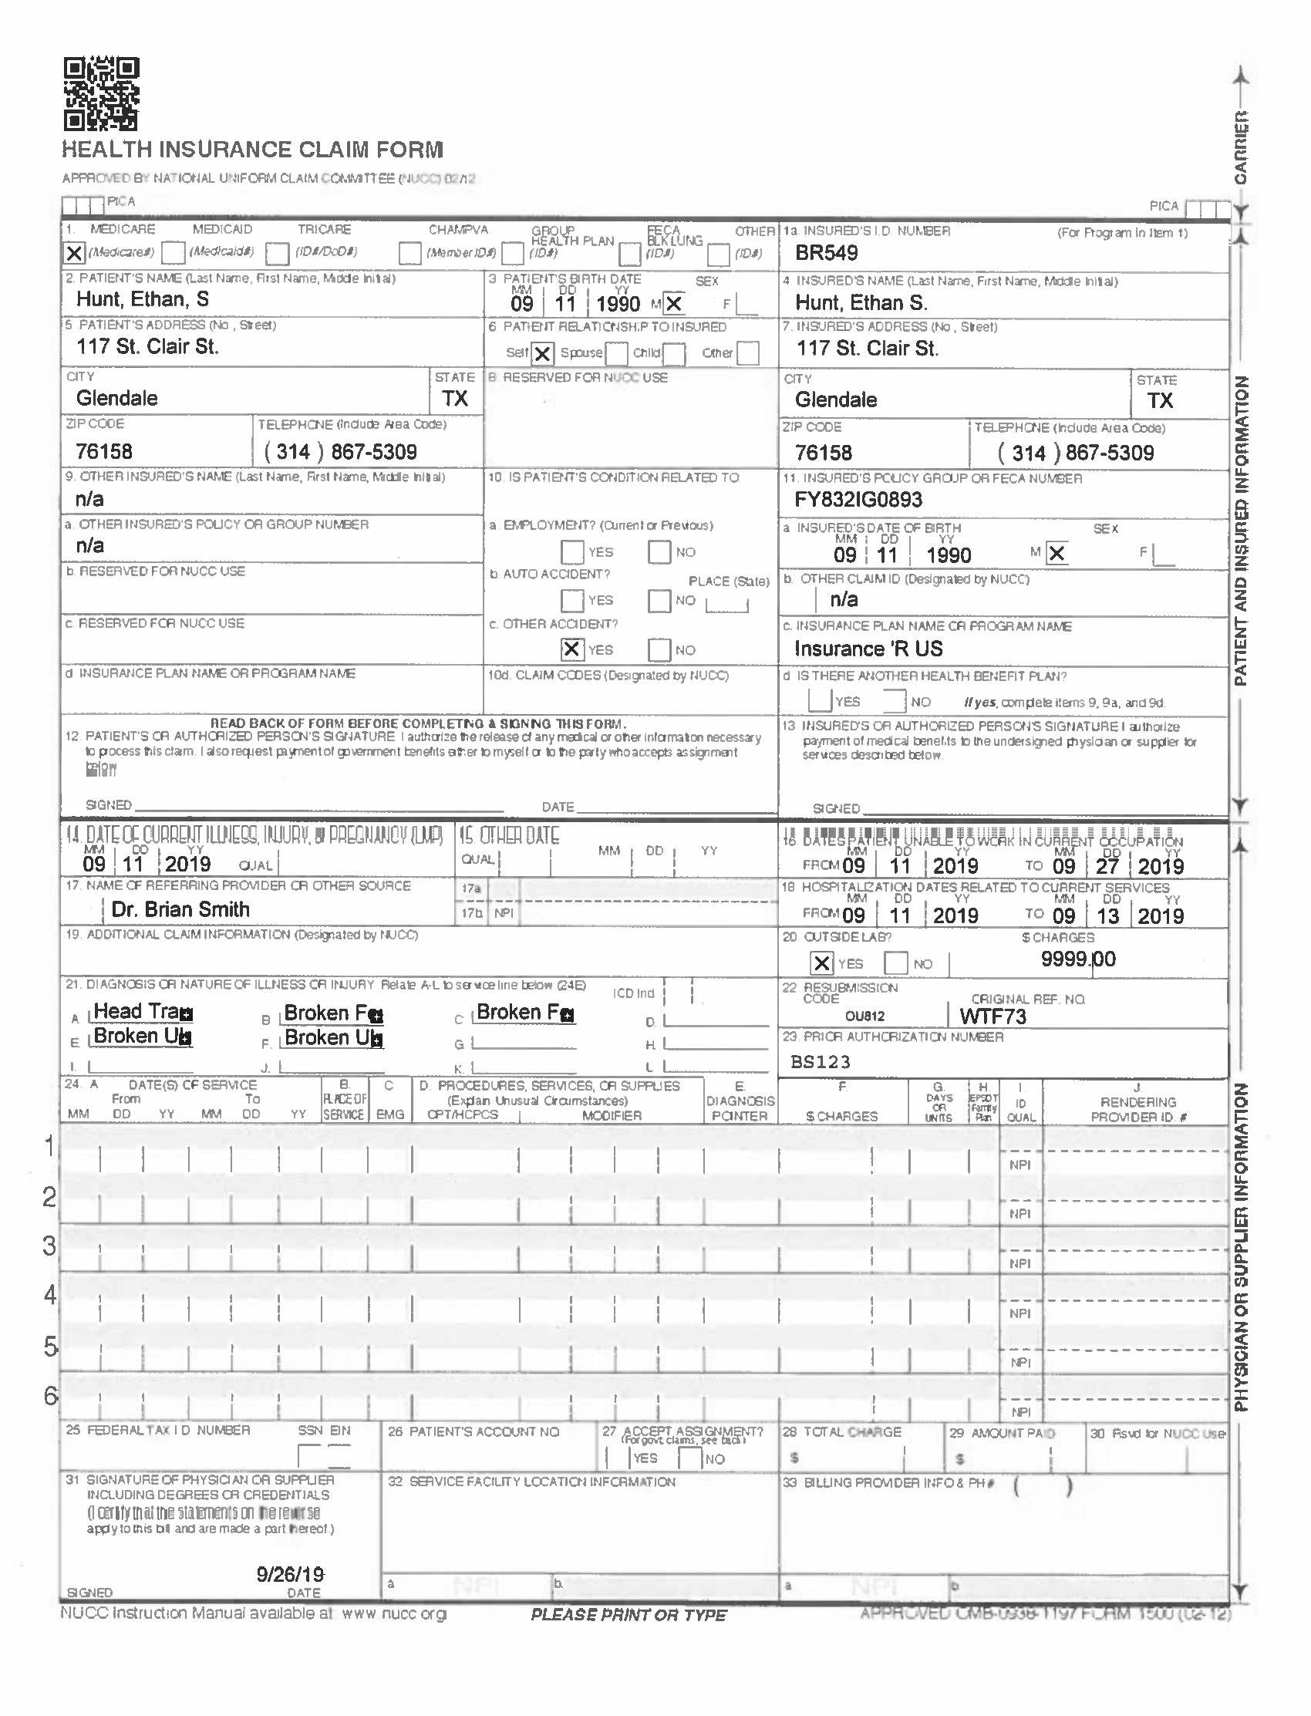
Rotate, Crop, Resize, and Overlay Filled Form and Blank Form
6

Slide 7
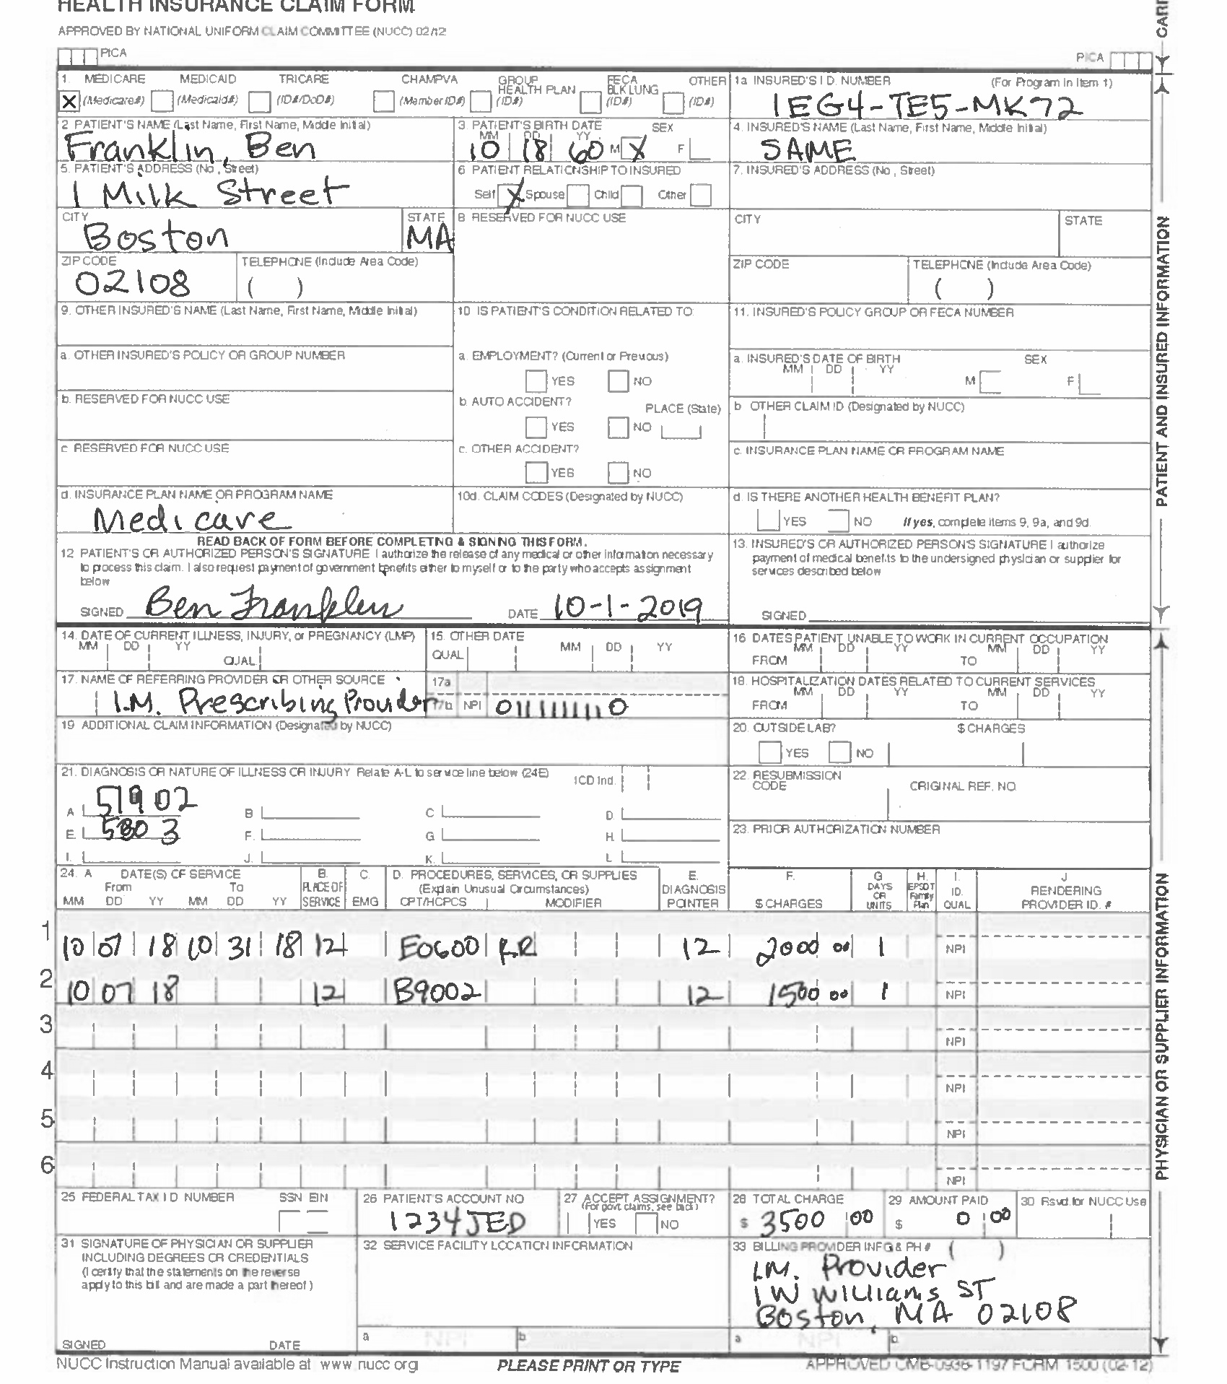
Rotate, Crop, Resize, and Overlay Filled Form and Blank Form
7

Slide 8
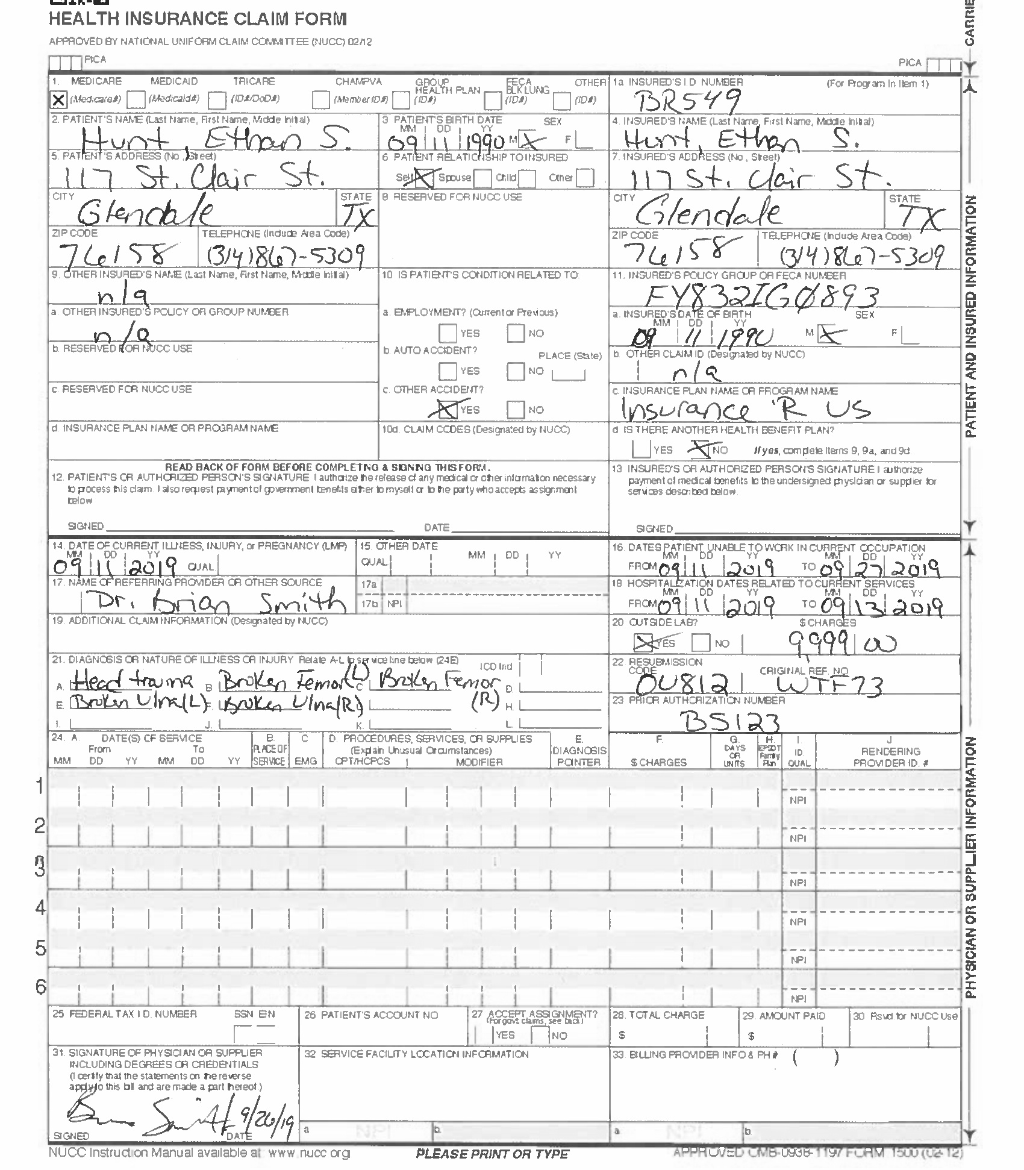
Rotate, Crop, Resize, and Overlay Filled Form and Blank Form
8

Slide 9
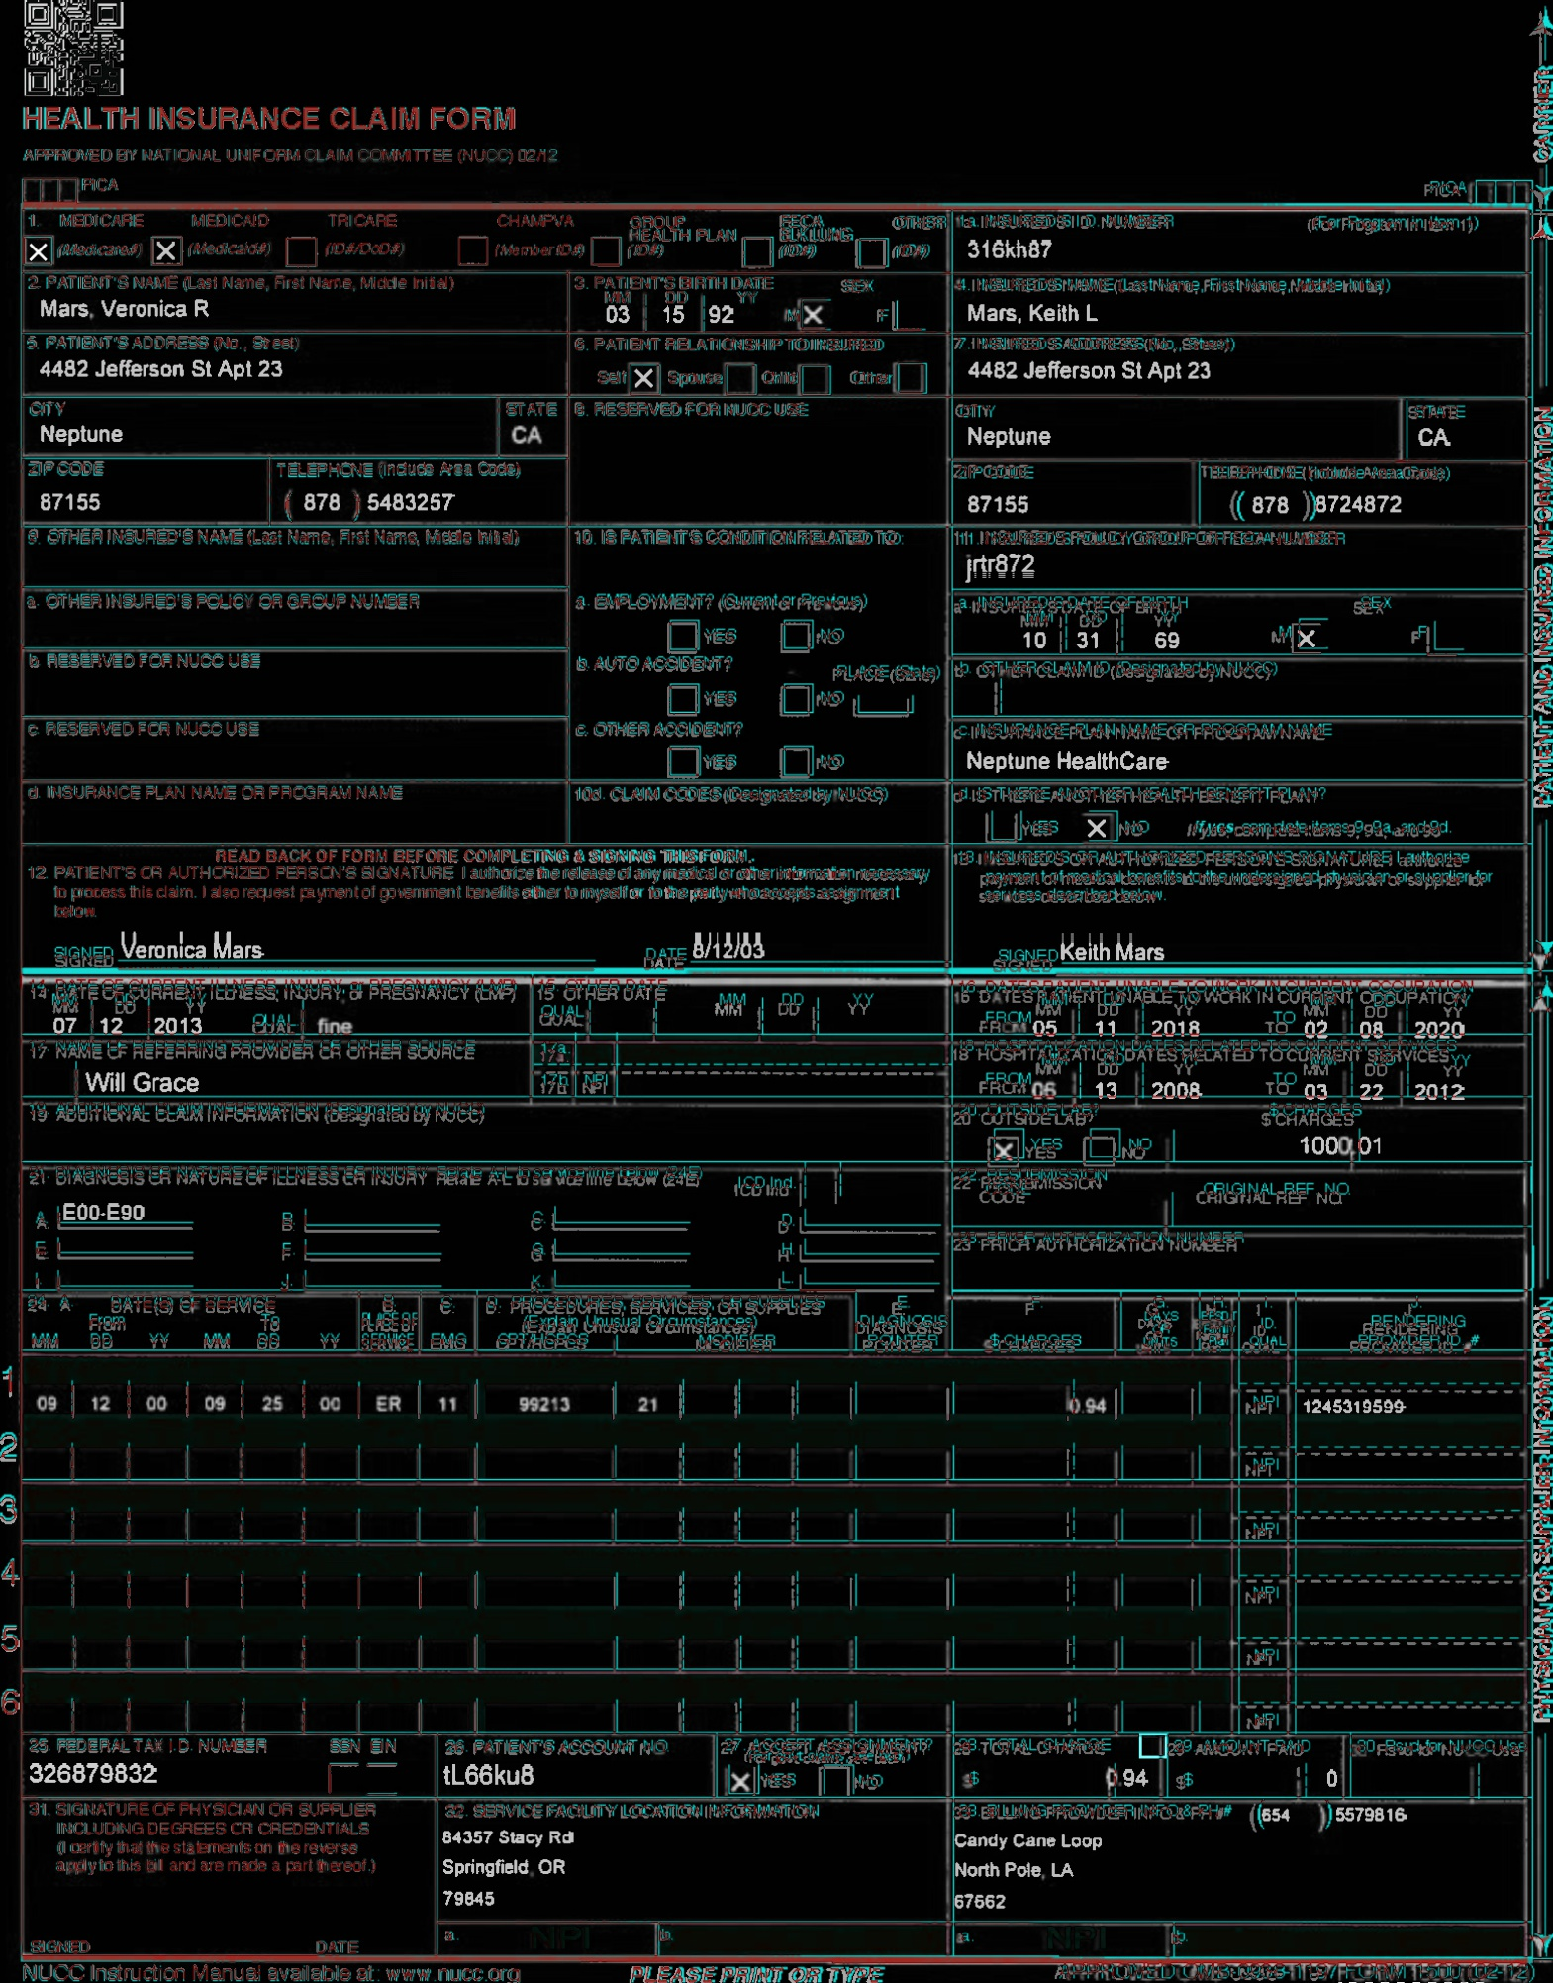
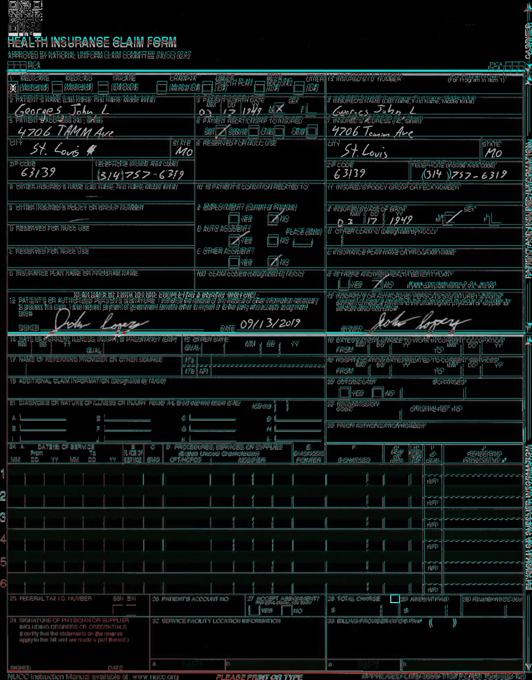
Rotate, Crop, Resize, and Overlay Filled Form and Blank Form
9
Notes:
Result from the transformations and then overlaying the forms on top of each other
May not work since cropping is done based on the red form background
9

Slide 10
Results
Our methods weren’t able to improve the existing process
Ability to generate synthetic data could be a value add

Slide 11
Methods Comparison
Method | Accuracy
IOU | 97.63%
Center | 55.92%
Left | 42.65%
EAST | 60.43%
11

Slide 12
Duplicate Existing Method Using Intersection of Bounding Boxes
Cost Associated with text extraction (Amazon Textract)
Lack of Bounding Boxes
Time cost of manually creating bounding boxes
12
Notes:
Three issues arose moving to the next stage of the project and they were
12

Slide 13
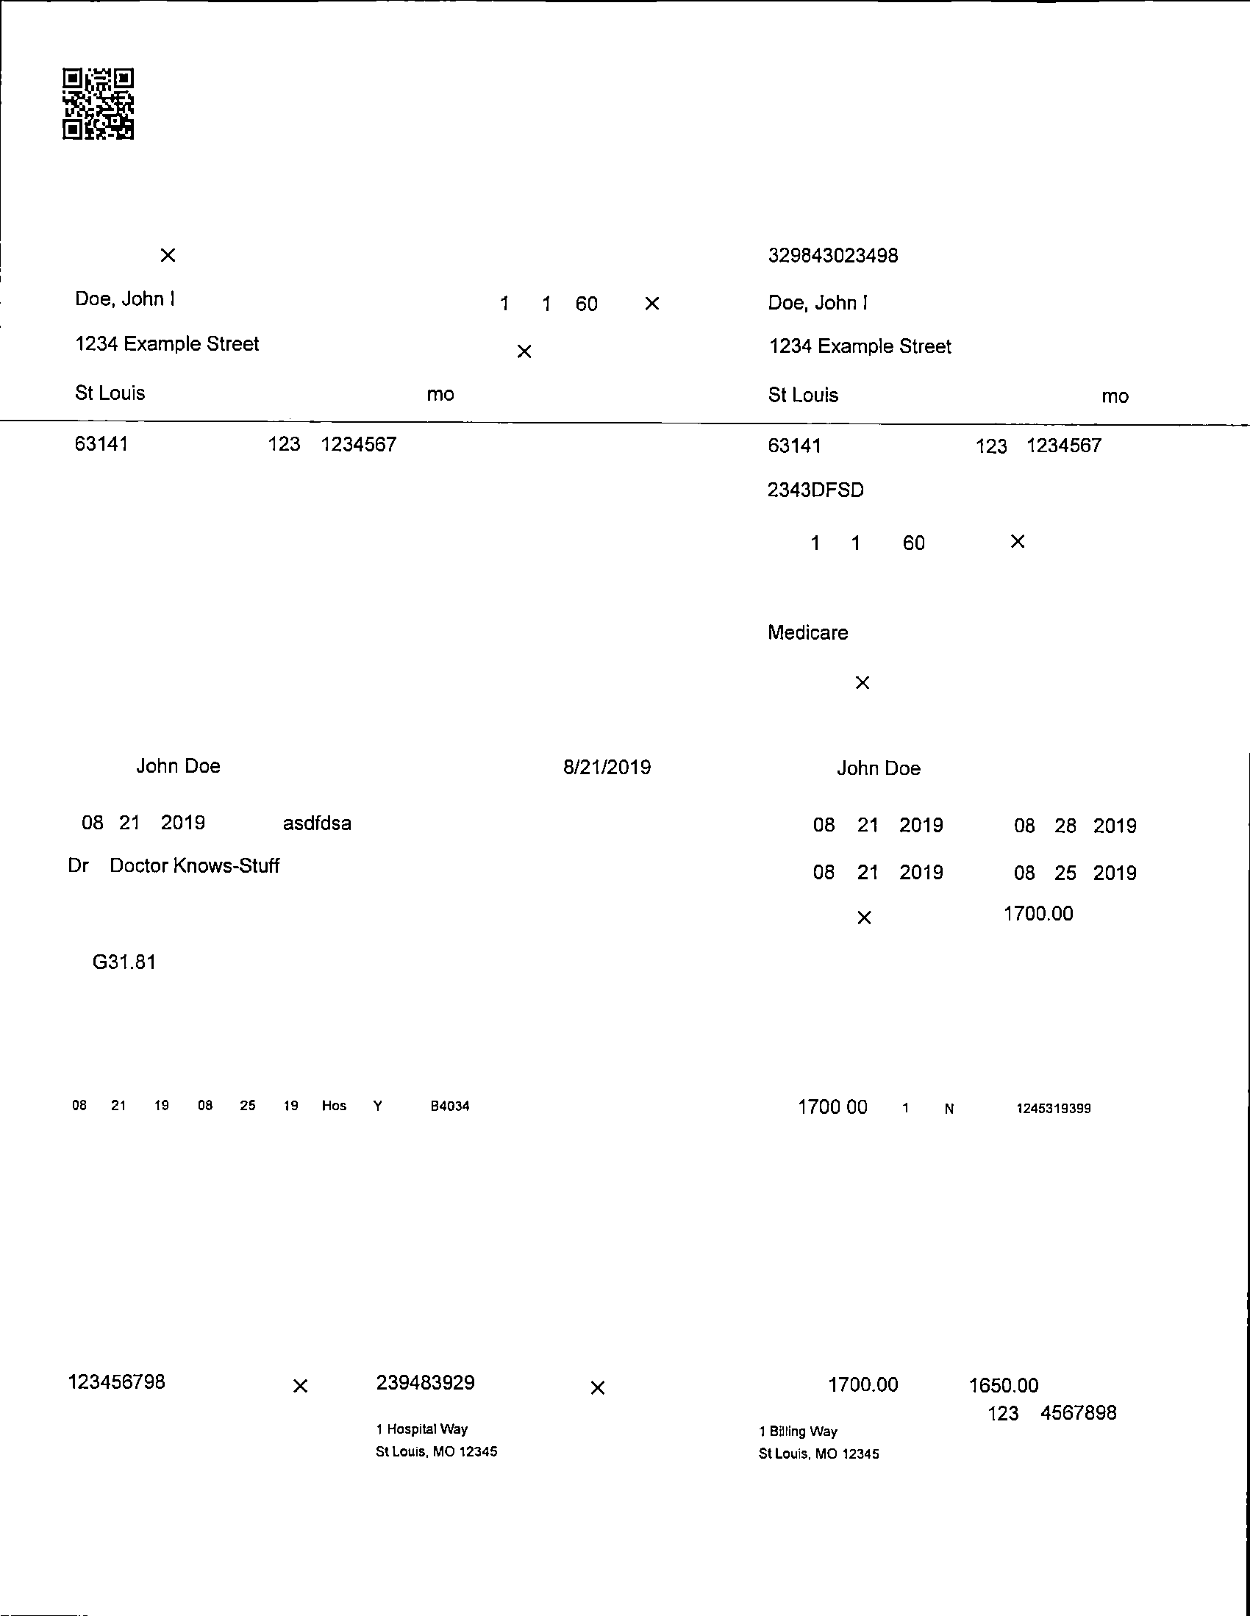
Duplicate Existing Method Using Intersection of Bounding Boxes
13
Notes:
White pages solved the first two problems
No longer needed a textraction software and could now programmatically bound the text because the noise created by the form background has been removed
Unfortunately no solution to the third one so I had to manually label each individual box
13

Slide 14
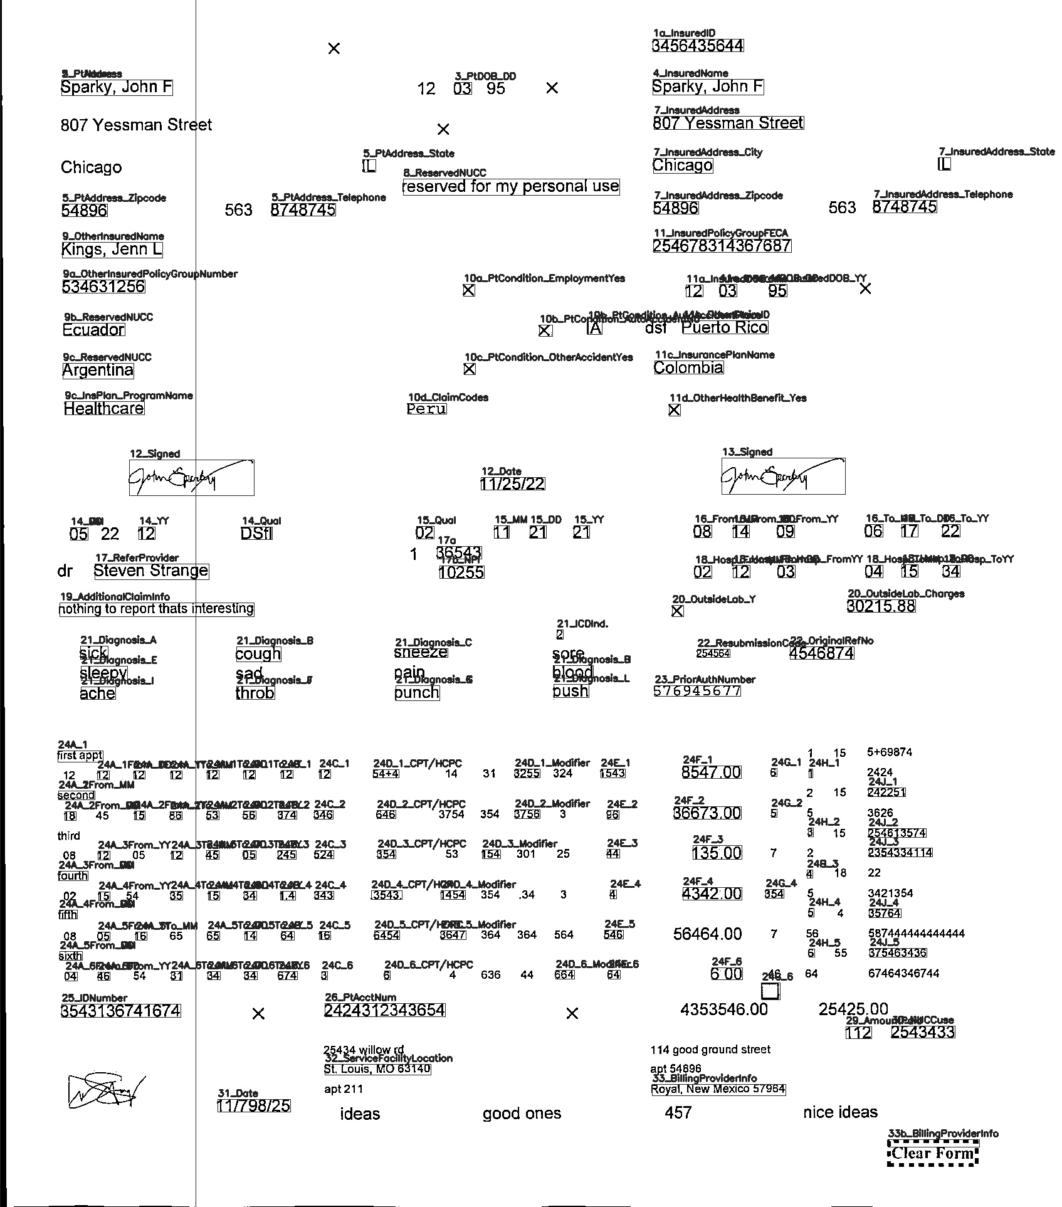
Duplicate Existing Method Using Intersection of Bounding Boxes
14
Notes:
Three issues arose moving to the next stage of the project and they were
14

Slide 15
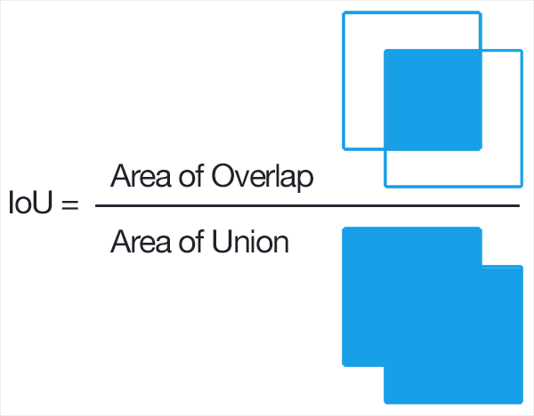
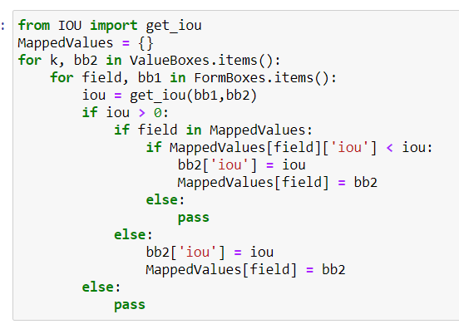
Duplicate Existing Method Using Intersection of Bounding Boxes
15
Notes:
The code on the screen then computes the IOU by comparing the top left and bottom right corners of the filled form and blank form fields
Don’t worry about the code this is what IOU represents
75% of boxes got a label
15

Slide 16
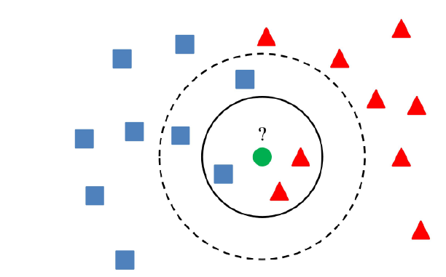
K-Nearest Neighbor
Supervised Machine Learning
16
Notes:
Three issues arose moving to the next stage of the project and they were
16

Slide 17
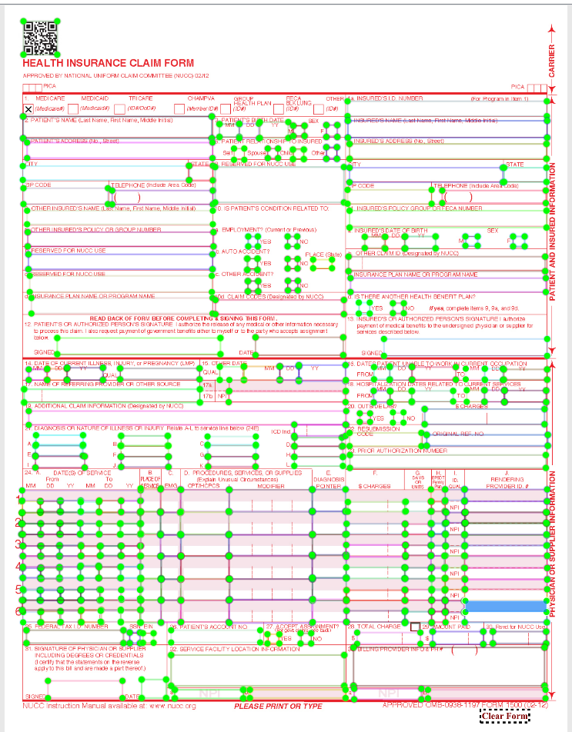
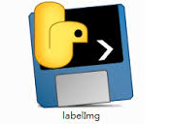
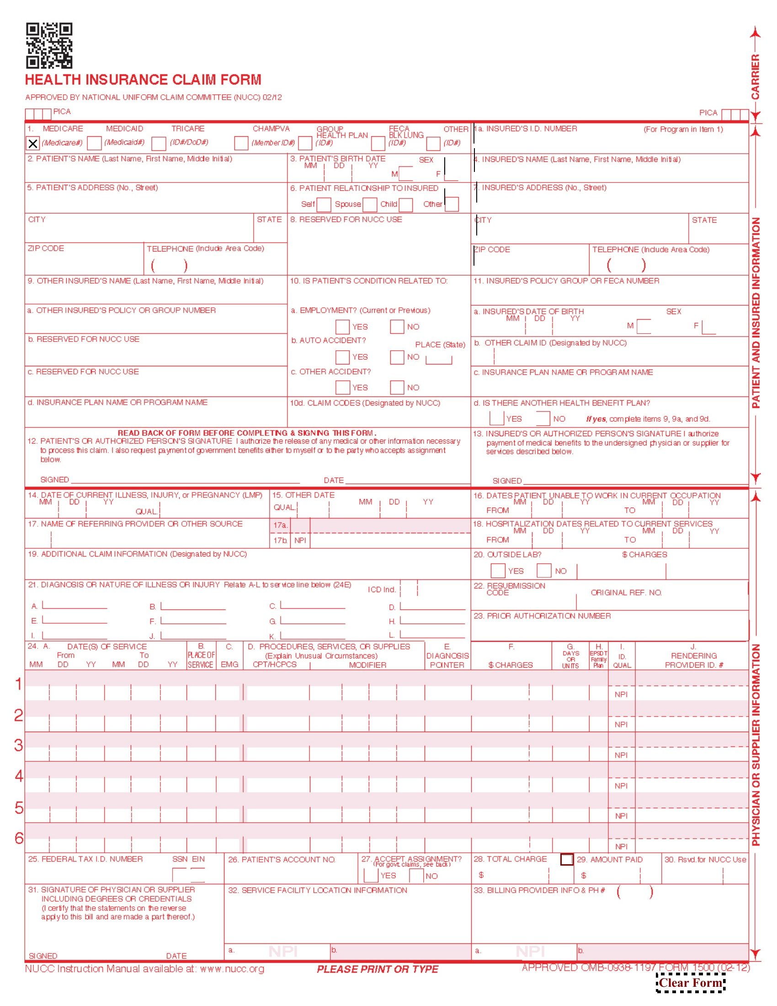
K-Nearest Neighbor Top-Left Corner
Accuracy | 99.69% | 1 neighbor
17
Notes:
Three issues arose moving to the next stage of the project and they were
17

Slide 18
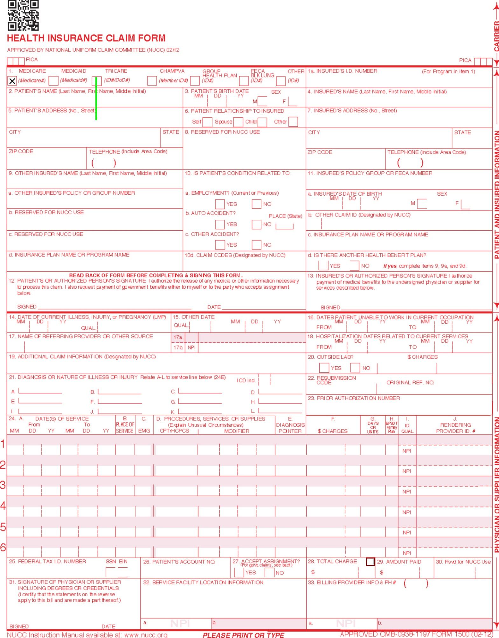
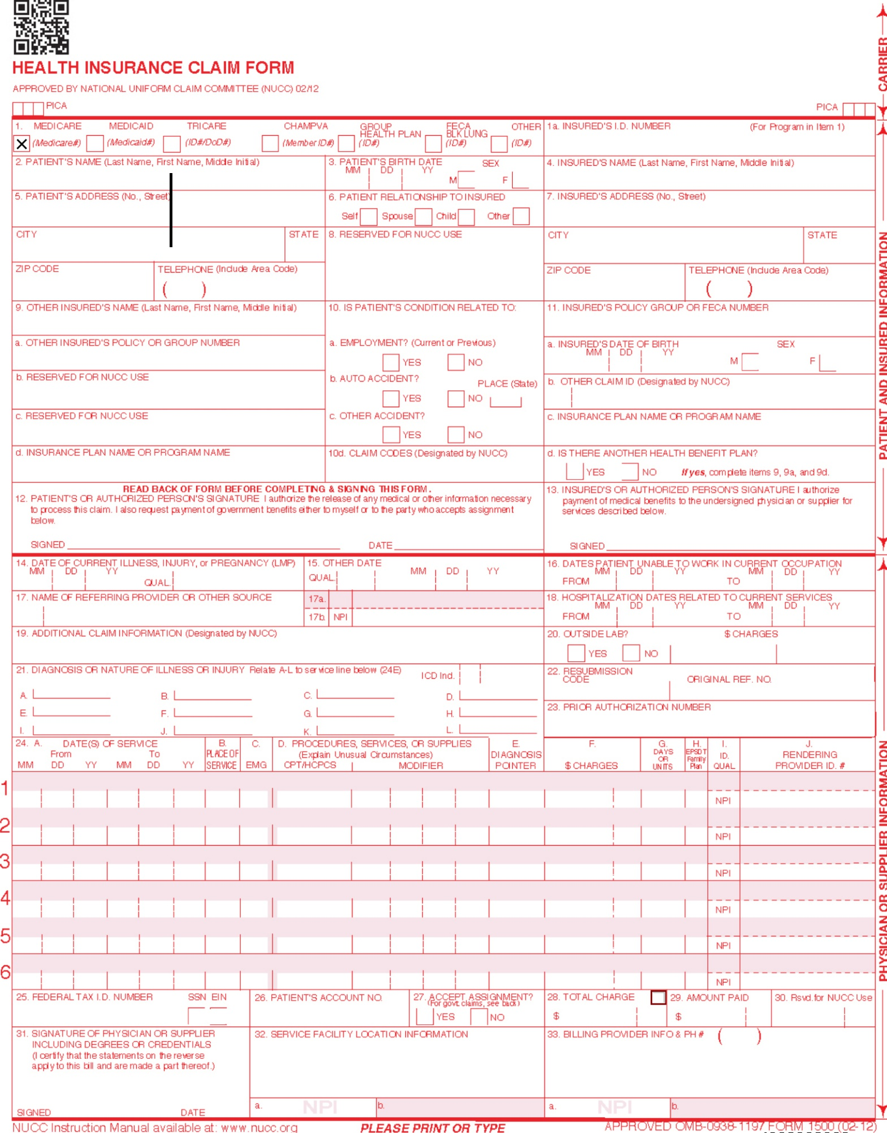
K-Nearest Neighbor Center Corner
Accuracy | 94.47% | 17 neighbors
18
Notes:
Add in more slides clarifying accuracy score

Slide 19
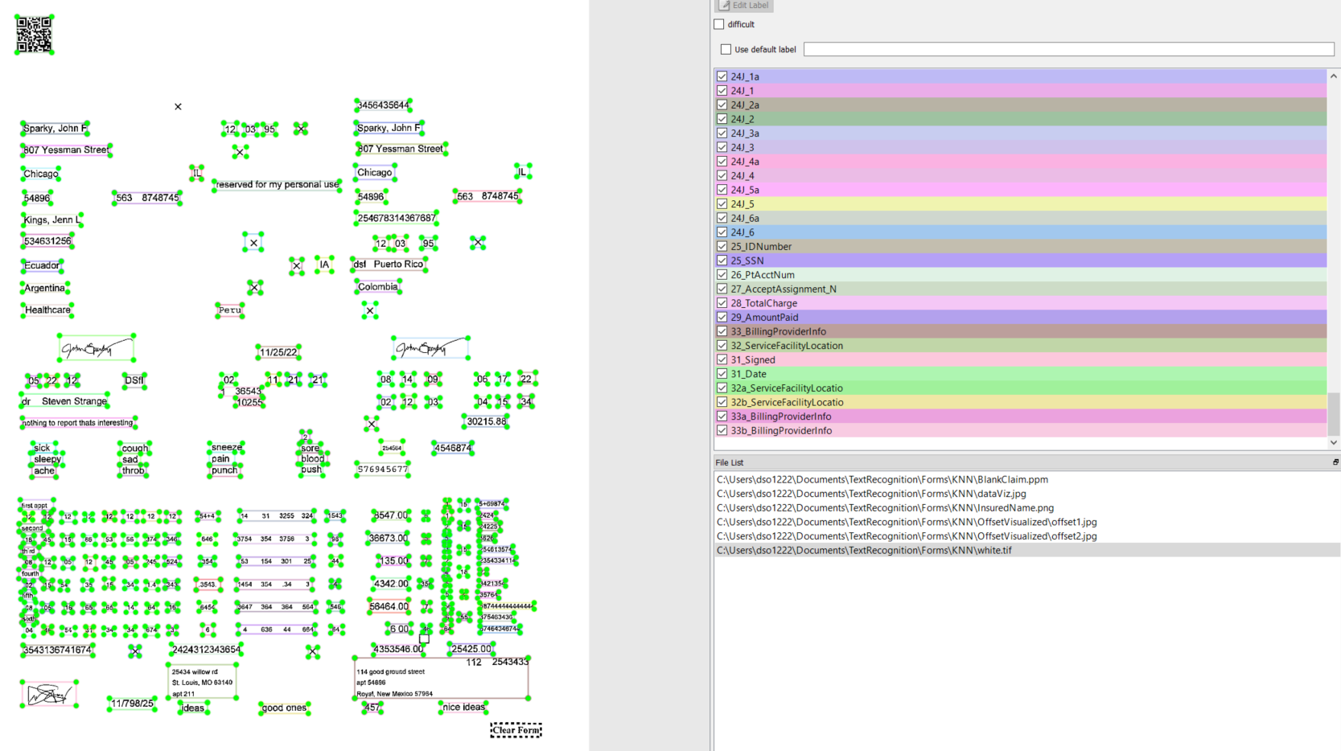
Methods Comparison
19

Slide 20
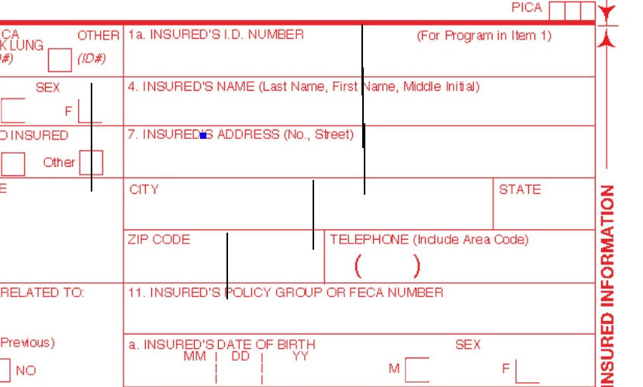
Methods Comparison
20

Slide 21
Location Prediction Using Tensorflow
OpenCV & EAST
Similar non-parametric method to KNN
Found text boxes in pdf using an implementation of EAST (Efficient and Accurate Scene Text) Detector

Slide 22
Future Iteration
Realistic training data should raise the accuracy of the KNN
Different KNN Point of Reference (offset center)
Text Classification to identify the category of text being extracted (names vs. address vs. cpt)
Feature Engineering
22

